Slide 1
Network Topologies
Network topology defines how devices are connected in a network
Physical topology shows the actual physical connections
Logical topology shows how data flows through the network
Common topologies include Bus, Star, Ring, Mesh, and Hybrid

Slide 2
Bus Topology
All devices share a single backbone cable
Data travels along the shared communication medium
Advantages: simple design, less cable, low initial cost
Disadvantages: backbone failure can affect the entire network
Difficult to troubleshoot and performance decreases as devices increase
Rarely used in modern LANs

Slide 3
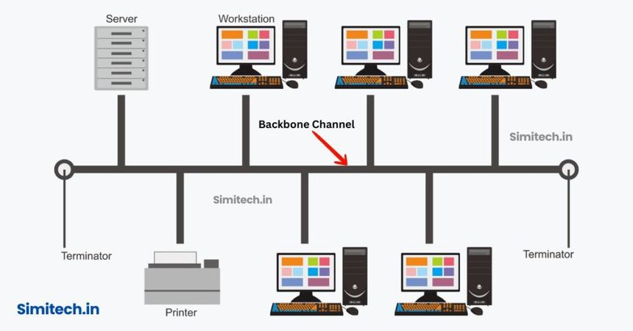

Slide 4
Star Topology
Every device has a separate connection to a central switch or hub
Most modern Ethernet LANs use a star-based design
Advantages: easy to install, manage, expand, and troubleshoot
Failure of one cable normally affects only one device
Disadvantage: failure of the central switch can affect connected devices

Slide 5
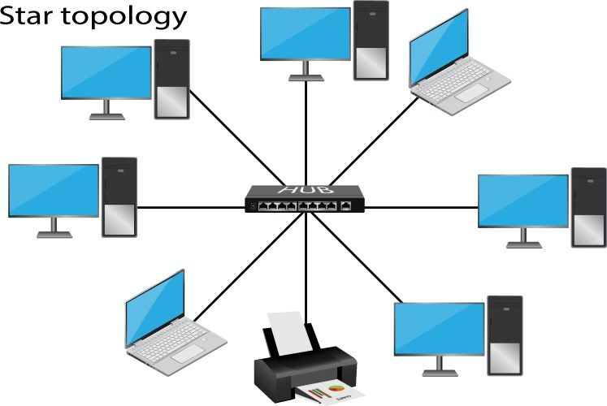

Slide 6
Ring Topology
Each device connects to two neighboring devices
Devices form a closed loop
Data travels around the ring
Advantages: predictable data flow and no central device required
Disadvantages: a connection failure can disrupt communication
Rare in modern LANs

Slide 7
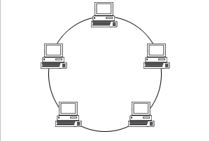

Slide 8
Mesh Topology
Devices have multiple paths to reach other devices
Provides redundancy and fault tolerance
Advantages: high reliability and multiple communication paths
Disadvantages: expensive and complex to configure and maintain
Common in critical network, WAN, and data-center designs

Slide 9
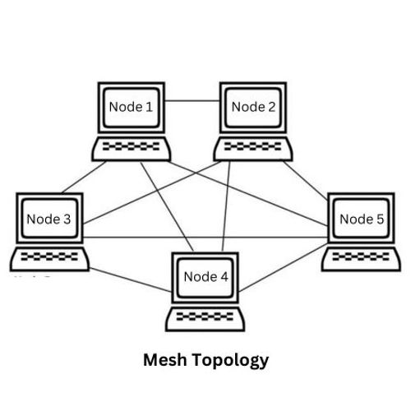

Slide 10
Hybrid Topology
Combines two or more topology types
Common in large enterprise networks
Advantages: flexible and scalable
Can be designed according to organizational requirements
Disadvantages: more complex, higher cost, and requires careful planning

Slide 11
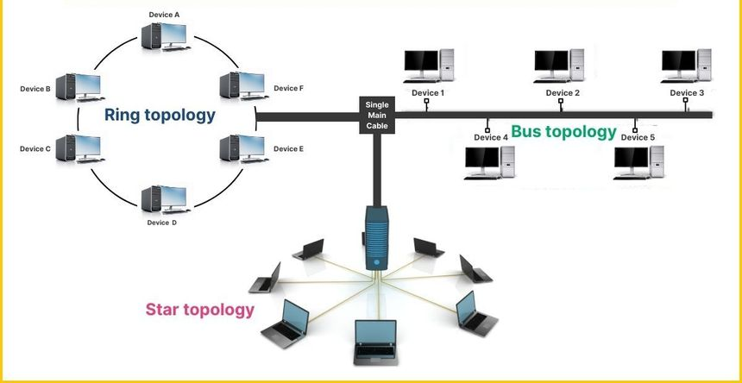

Slide 12

Topology Comparison
Bus - Single backbone - Low reliability - Rare today
Star - Central switch - Good reliability - Very common
Ring - Closed loop - Medium reliability - Rare
Mesh - Multiple paths - Very high reliability - Critical networks
Hybrid - Combination of topologies - Depends on design - Common in enterprise networks
Key point: Star is the most common topology for modern Ethernet LANs

Slide 13

What is a Communication Model?
A communication model describes how devices exchange data
It explains how communication responsibilities are divided
Two important models are Client-Server and Peer-to-Peer

Slide 14

Client-Server Model
The client requests a service
The server provides the requested service
Servers can centrally manage resources, authentication, applications, and data
Examples: web browser to web server, email client to mail server, application to database server

Slide 15
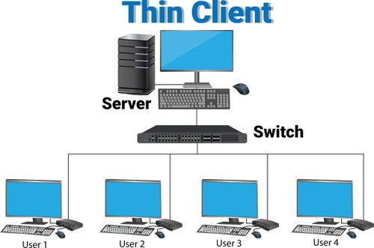

Slide 16

Peer-to-Peer Model
Devices communicate directly with each other
A dedicated central server is not required for the shared service
Each device can act as both a client and a server
Examples: direct file sharing and some decentralized applications
Advantages: simple for small networks, low cost, and no dedicated server required
Disadvantages: difficult to manage as the network grows and less centralized security

Slide 17
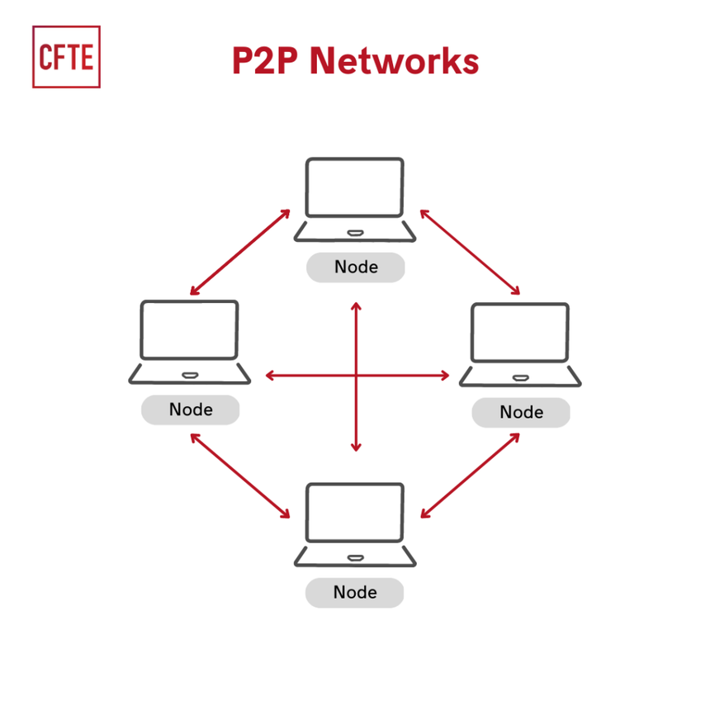

Slide 18
Client-Server vs Peer-to-Peer
Client-Server: uses a central server and centralized management
Client-Server: easier centralized security and highly scalable
Client-Server examples: web, Active Directory, and database services
Peer-to-Peer: no central server is required and management is distributed
Peer-to-Peer: lower cost but harder to manage and secure at scale
Peer-to-Peer example: direct computer-to-computer file sharing

Slide 19
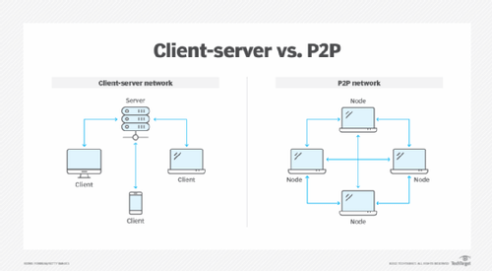

Slide 20

Communication Models in Real Networks
A real network can use both client-server and peer-to-peer communication
Client-server examples: PC to Web Server, DNS Server, File Server, or Domain Controller
Peer-to-peer example: direct PC-to-PC communication
The model depends on the service being provided and the network design

Slide 21

OSI Communication Model
The OSI model explains network communication using seven layers
Layer 7 Application - Network services to applications
Layer 6 Presentation - Data representation and encryption concepts
Layer 5 Session - Session management
Layer 4 Transport - End-to-end delivery using TCP or UDP
Layer 3 Network - IP addressing and routing
Layer 2 Data Link - Frames and MAC addressing
Layer 1 Physical - Bits, cables, and radio signals

Slide 22
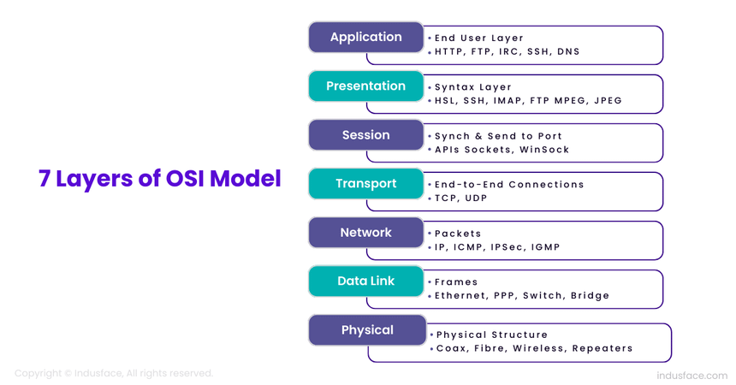

Slide 23
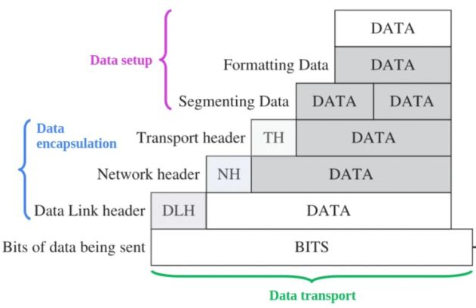
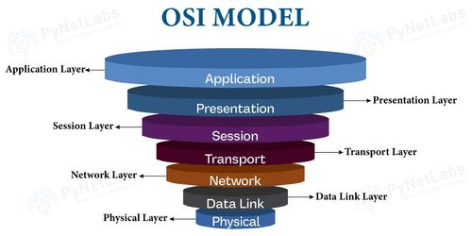

Slide 24

Encapsulation
Application layer produces data
Transport layer adds transport information and creates a segment
Network layer adds IP information and creates a packet
Data Link layer adds frame information
Physical layer transmits bits
At the receiver, data is processed upward in reverse order
Key concept: each layer adds information required for transmission

Slide 25
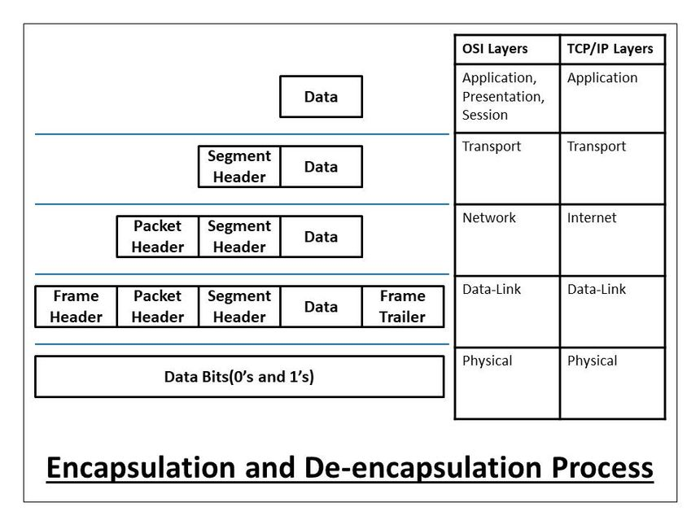

Slide 26
TCP/IP Suite
The Practical Networking Model
TCP/IP stands for Transmission Control Protocol / Internet Protocol
It is the protocol suite used by the Internet and modern networks
Commonly represented using 5 layers
Each layer performs a specific networking function

Slide 27
